Slide 1

Finding Likely Term-Deposit Subscribers
Under Class Imbalance
A Machine Learning Study of Bank Telemarketing
Chaoran Chen · Haoyang Liu · Haonan Li
474 · Final Project · 2026
474 Final
Notes:
Good morning. We are presenting our STAT 474 final project on predicting which bank clients subscribe to term deposits under class imbalance. I'm [Name], joined by [Names]. [transition cue] I will begin with the targeting problem.

Slide 2
The Targeting Problem
Predicted No
Predicted Yes
TN
FP
Actual No
correctly skipped
wasted call
Costly calls sell term deposits
False positives waste call cost
FN
TP
False negatives lose revenue
Actual Yes
lost revenue
successful call
Goal: rank clients before the call
Cost matrix: false negatives lose revenue; false positives waste call cost.
Maximize positive recall under workable precision
Notes:
Retail banks rely on telemarketing to sell term deposits. Every call has a cost, and every missed subscriber is lost revenue. So the bank wants a model that ranks clients by subscription likelihood before any outreach. Our project answers five research questions, the most important being: which methods best identify subscribers when the positive class is rare? Throughout the talk, keep this two-by-two trade-off in mind: false negatives lose revenue, and false positives waste call cost. [transition cue] Now let's look at the data.

Slide 3
Dataset & Imbalance Challenge
Subscribed
Not subscribed
Item | Value
Observations | 41,188
Predictors after preprocessing | 20
Positive class: subscribed | 4,640
Positive rate | 11.27%
Raw NA count | 0
11.27%
88.73%
All-No classifier: 88.73% accuracy, zero recall.
Accuracy is misleading.
Table 1. Dataset summary after preprocessing.
Positive class is rare but business-critical
Use PR-AUC, F1, recall, precision
Imbalance drives every modeling choice
Notes:
The data come from the UCI Bank Marketing repository, originally studied by Moro and colleagues in 2014. We have 41,188 customers and 20 predictors after preprocessing. The catch is that only 11.27 percent of clients actually subscribed. A trivial classifier that says No to everyone reaches 88.73 percent accuracy, but recovers zero subscribers. So accuracy is a trap. Throughout the project, we evaluated models with PR-AUC, F1, recall, and precision instead. Class imbalance is the central reason behind every modeling decision later in this talk. [transition cue] Three preprocessing decisions follow directly from this challenge.

Slide 4
Three Preprocessing Decisions
01
02
03
Drop duration
Split pdays
Keep unknown
Recorded after the call
post-contact leakage
999 is a sentinel,
not a day count
Missingness can be
operational information
Removed before modeling
pdays_contacted + pdays_days
Valid factor level
Categorical variables -> factor + dummy.
Numeric -> centered and scaled where applicable.
Notes:
Three preprocessing decisions that any auditor will ask about. First, we removed call duration. It is only known after the call ends, so including it would leak post-contact information into a pre-contact prediction model. Second, pdays uses 999 to mark clients never contacted before, which is a sentinel, not a number. We split it into a binary flag and a numeric day count. Third, the unknown level in categorical variables is kept, not deleted or imputed, because missingness itself can carry operational signal. These choices preserve information without leaking it. [transition cue] Speaker B will now walk through what the data showed us.

Slide 5
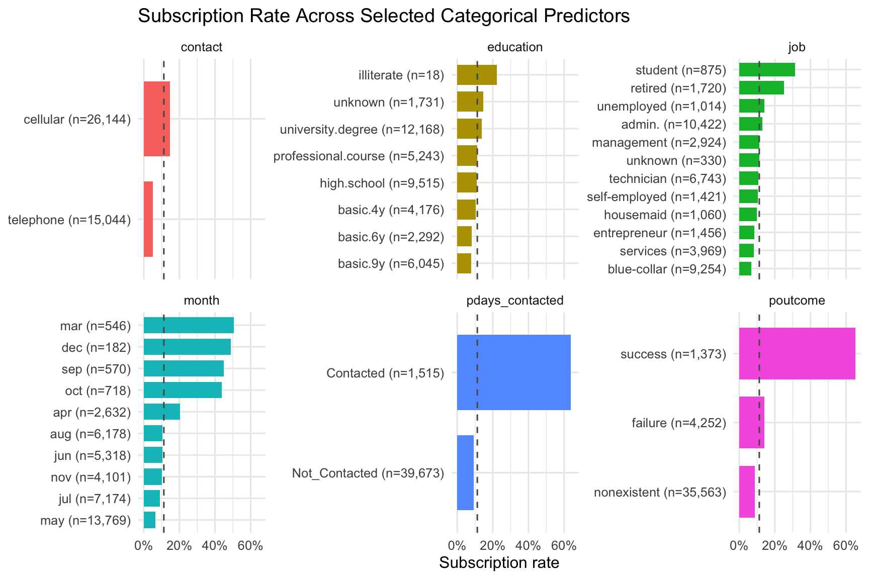
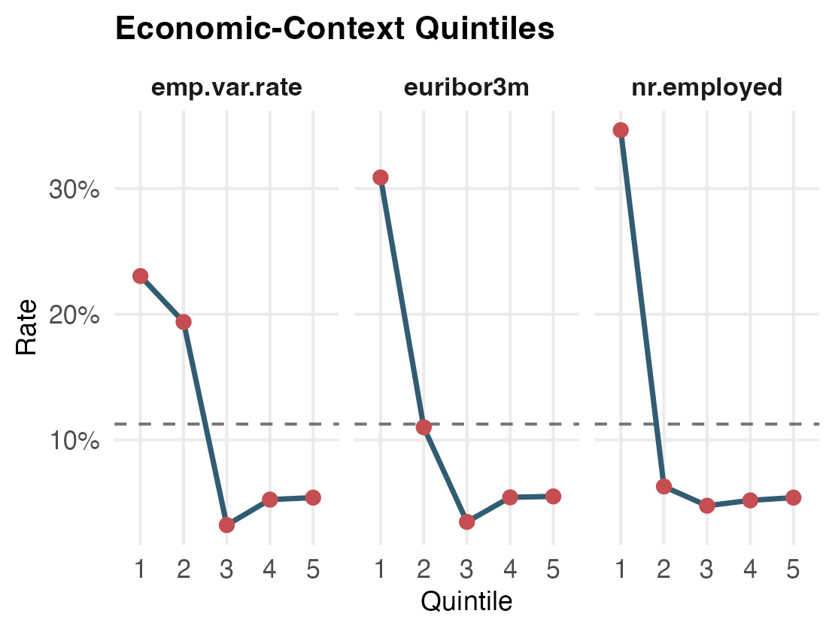
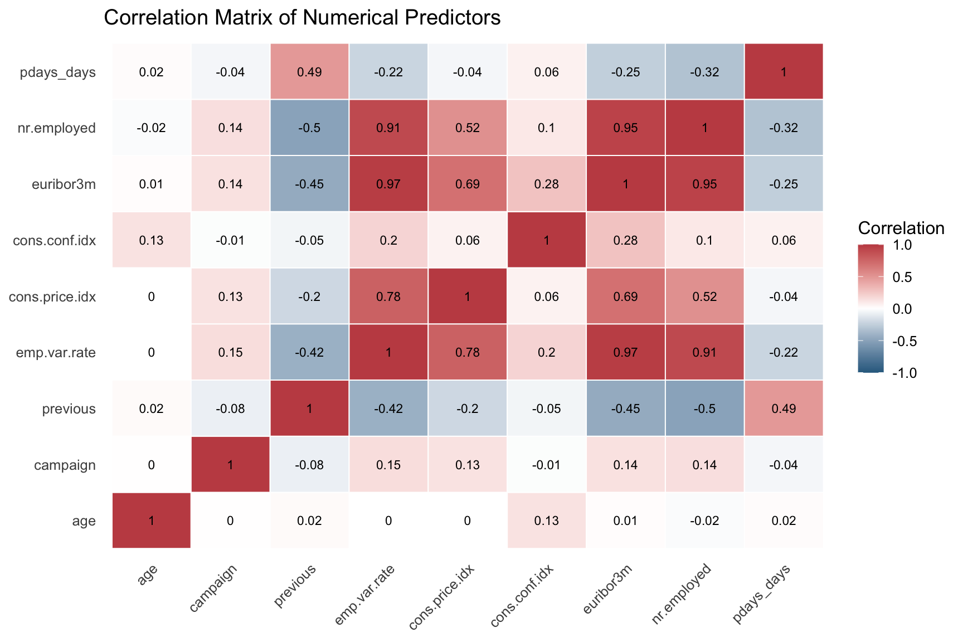
What EDA Revealed
Figure 1. Subscription rates across selected categorical predictors.
Figure 2. Subscription rates by quintile for emp.var.rate, euribor3m, and nr.employed. The dashed line marks the overall positive-class baseline.
Figure 3. Correlation matrix for numeric predictors.
Previously contacted: 63.83% vs 9.26%
Cellular beats telephone: 14.74% vs 5.23%
Macro variables are highly redundant
Notes:
EDA gave us three actionable signals. Figure 1 shows that prior contact and prior campaign success are massively predictive: 63.83 percent subscription among previously contacted clients versus 9.26 percent otherwise. Cellular contact also beats telephone contact, and certain months, especially March, October, and December, beat the baseline. Figure 3 shows the macroeconomic predictors carry near-duplicate information: emp.var.rate and euribor3m correlate at 0.97. This redundancy directly motivates the regularization, tree ensembles, and PCA we compare next. [transition cue] Here is the full pipeline that produced our final comparison.

Slide 6
Modeling Pipeline
Full data
41,188
Stratified
80/20 split
5-fold CV
on training
Threshold tuning
on OOF probabilities
Single test-set
evaluation
Same folds · PR-AUC tunes params · OOF F1 tunes thresholds · Test held out
STAT 474 Final · Slide 6 / 12 · Speaker B
Notes:
Our pipeline has three separate decisions. First, model parameters are tuned inside the training set with five-fold cross-validation, using PR-AUC because the Yes class is rare. Second, every training observation gets an out-of-fold probability from a model that did not train on that observation; those probabilities are used to choose the F1-maximizing threshold. Third, the held-out test set is touched only once after parameters and thresholds are locked. The positive class is also up-weighted during fitting so subscribers carry more influence than the majority No class. [transition cue] Six models now compete under the same validation protocol.

Slide 7
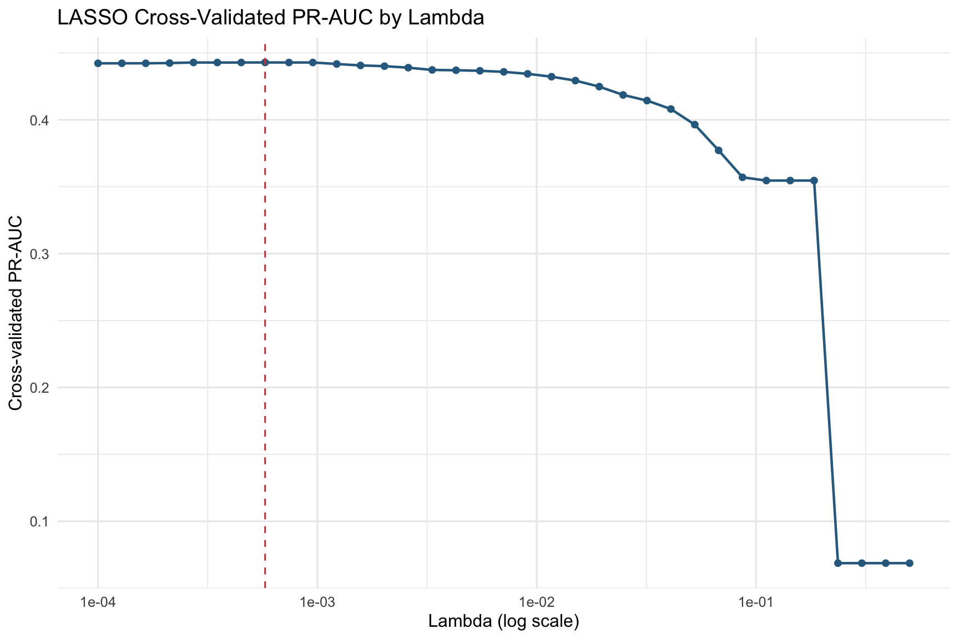
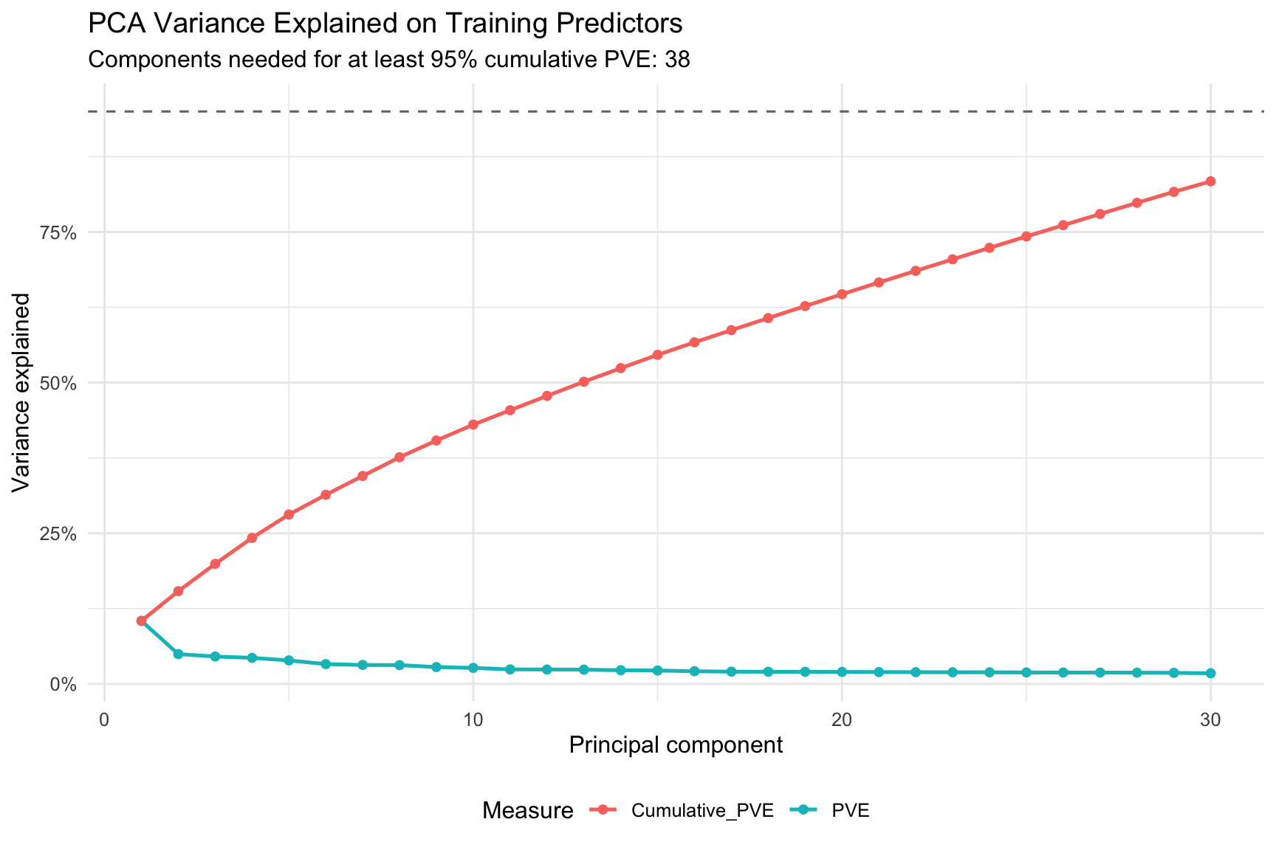
Six Models, Same CV Protocol
Model | One-line idea | Tuned hyperparameter | Role
Logistic Regression | Linear log-odds | - | Interpretable baseline
LASSO Logistic | + L1 sparsity | lambda via CV | Feature selection benchmark
Naive Bayes | Conditional independence | Laplace in {0, 1} | Generative benchmark
Random Forest | Bagged decision trees | mtry, min.node.size | Strong nonparametric ensemble
Weighted XGBoost | Boosting + class weights | depth, lr, subsample, regularization | Final winner
PCA + Logistic | 38 PCs -> linear | 95% PVE rule -> 38 PCs | Dimensionality benchmark
Figure 4. LASSO PR-AUC by lambda.
Figure 5. PCA variance explained.
Notes:
All six models share folds and the same evaluation protocol. Logistic regression is the linear baseline. LASSO adds an L1 penalty, and lambda is chosen by five-fold PR-AUC. Naive Bayes only compares Laplace smoothing at 0 versus 1. Random Forest tunes mtry and minimum node size; the best setup is conservative, with feature subsampling and larger leaves. Weighted XGBoost searches sampled tree settings with class weights. PCA plus logistic is the important caveat: 38 components are not CV-selected; they come from the 95 percent cumulative variance rule, and cross-validation evaluates that full PCA-logistic pipeline. [transition cue] Speaker C will show the cross-validated comparison and threshold choices.

Slide 8
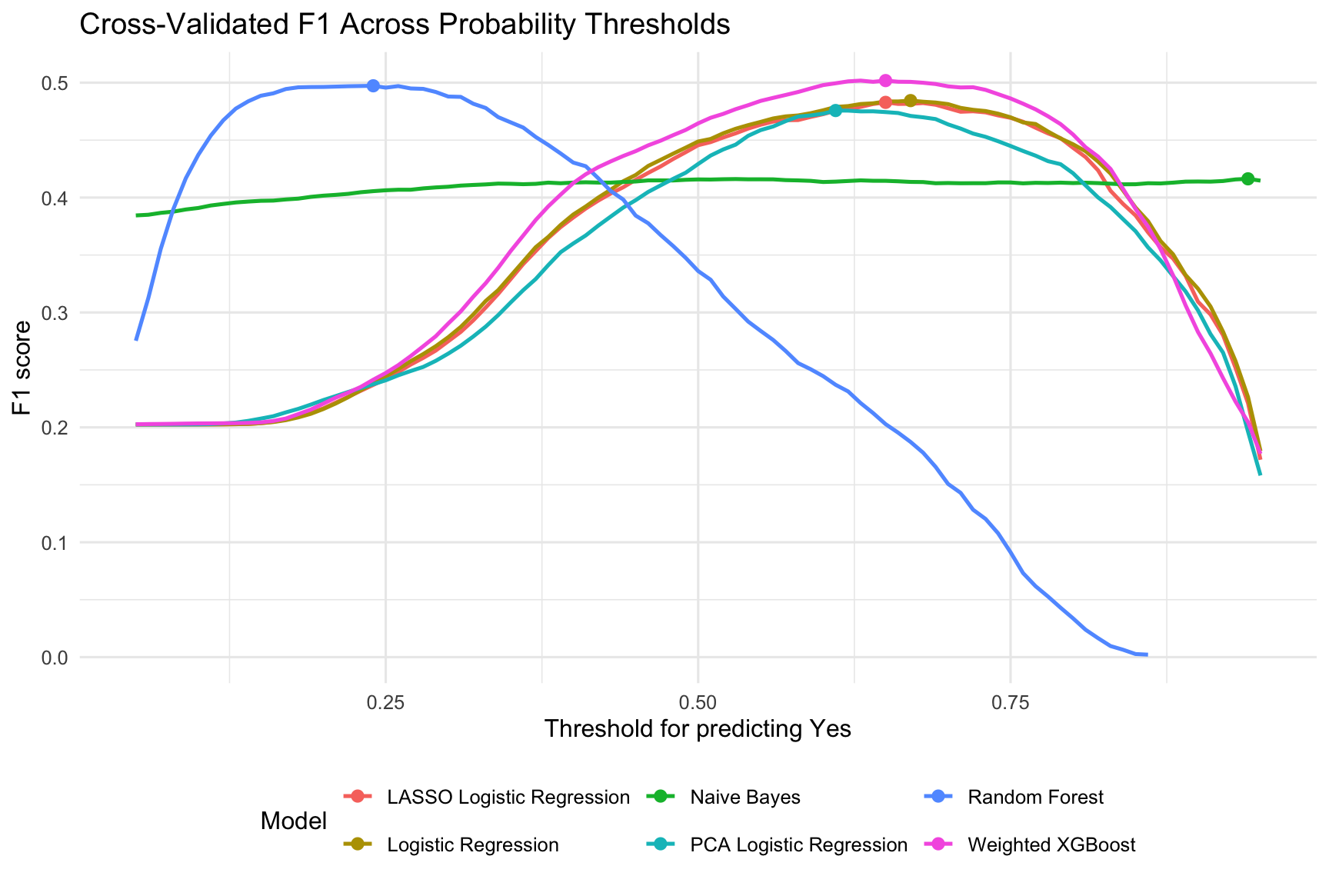
CV Results & F1 Thresholds
Model | CV PR-AUC | Threshold | CV F1
Random Forest | 0.4593 | 0.24 | 0.4973
Weighted XGBoost | 0.4565 | 0.65 | 0.5018
LASSO Logistic | 0.4429 | 0.65 | 0.4829
Logistic | 0.4416 | 0.67 | 0.4844
PCA Logistic | 0.4210 | 0.61 | 0.4758
Naive Bayes | 0.3265 | 0.94 | 0.4163
Table 3. Simplified CV comparison and F1 threshold selection.
Thresholds vary from 0.24 to 0.94
because probability scales differ by model
Figure 6. Cross-validated F1 across thresholds.
Notes:
Cross-validated PR-AUC, our primary metric for model complexity, narrows the field. Random Forest and Weighted XGBoost lead by a hair, while Naive Bayes is well behind, confirming the independence-assumption problem. After that, threshold selection is a separate step using out-of-fold probabilities and cross-validated F1. Random Forest peaks at 0.24, linear models around 0.65, and Naive Bayes needs 0.94, so one universal 0.50 cutoff would be misleading. Each model carries its own cross-validated threshold into the test-set evaluation. [transition cue] Now the held-out test set.

Slide 9

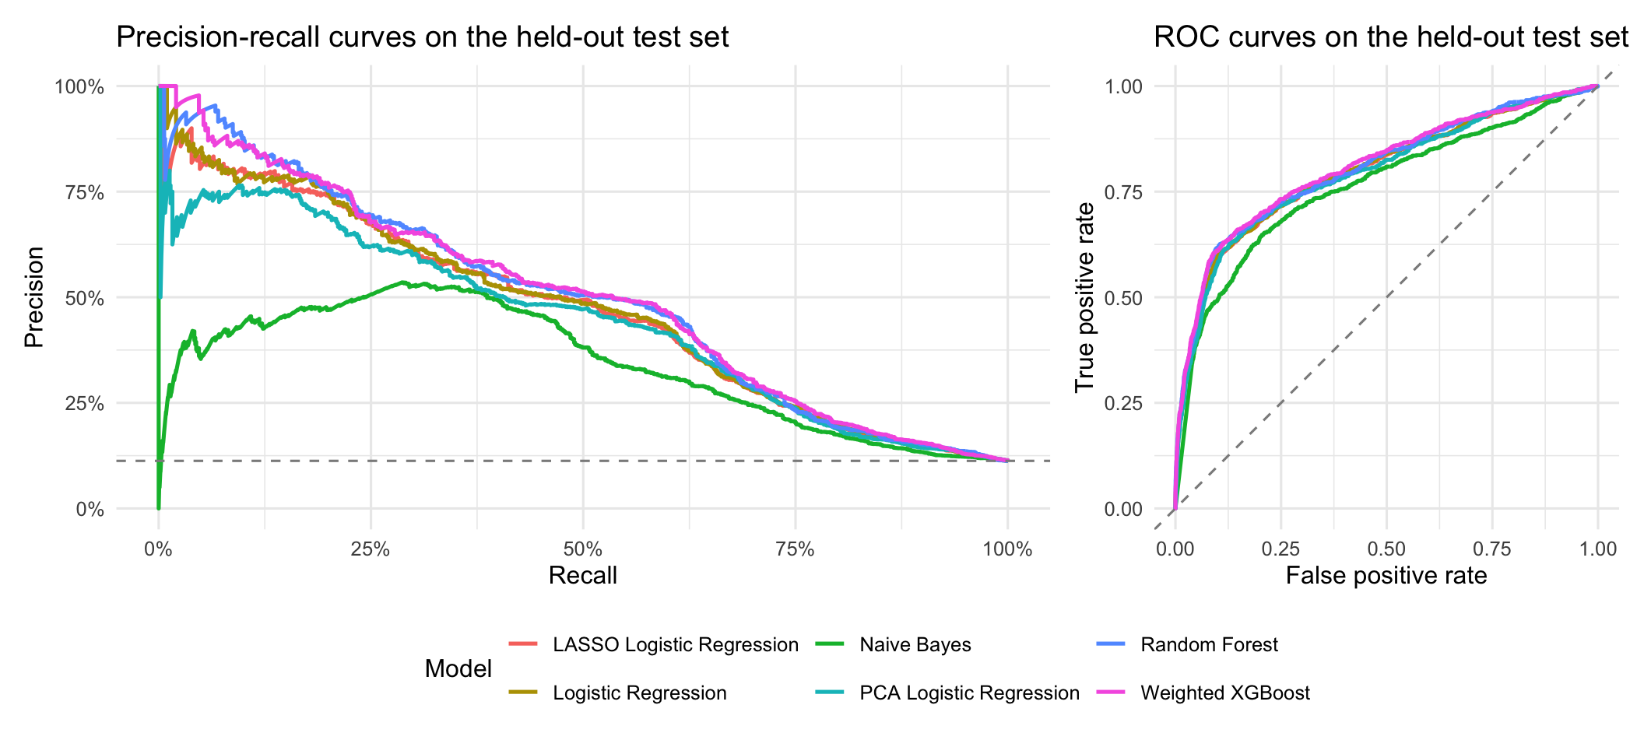
Held-Out Test Performance
Model | Thr. | Acc. | Prec. | Recall | F1 | ROC-AUC | PR-AUC
Weighted XGBoost | 0.65 | 0.8776 | 0.4663 | 0.5970 | 0.5236 | 0.8092 | 0.5009
Random Forest | 0.24 | 0.8786 | 0.4689 | 0.5851 | 0.5206 | 0.8048 | 0.4966
Logistic | 0.67 | 0.8718 | 0.4468 | 0.5787 | 0.5042 | 0.7982 | 0.4731
LASSO | 0.65 | 0.8662 | 0.4314 | 0.5894 | 0.4982 | 0.7974 | 0.4692
PCA Logistic | 0.61 | 0.8609 | 0.4168 | 0.5884 | 0.4879 | 0.7938 | 0.4454
Naive Bayes | 0.94 | 0.8557 | 0.3886 | 0.4903 | 0.4335 | 0.7627 | 0.3392
Table 4. Held-out test performance using cross-validated thresholds.
Recommended model: Weighted XGBoost — highest F1, ROC-AUC, and PR-AUC
Figure 9. Precision-recall and ROC curves on the held-out test set.
XGBoost and Random Forest lead across thresholds.
Notes:
On the held-out test set, Weighted XGBoost wins on F1, PR-AUC, and ROC-AUC. It identifies 554 of 928 true subscribers, or about 60 percent recall, with 634 false positives. Random Forest is essentially tied, with marginally higher precision but slightly lower recall, missing 11 more subscribers. The linear models stay competitive given their simplicity but fall short on PR-AUC, indicating weaker ranking of rare positives. Naive Bayes is last, as its independence assumption clashes with correlated macro variables. The all-No baseline would have 88.73 percent accuracy with zero F1. [transition cue] What is the model actually using?

Slide 10
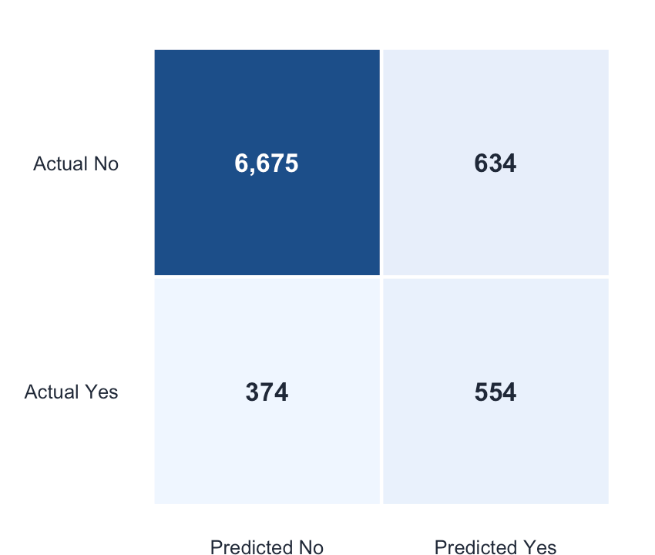
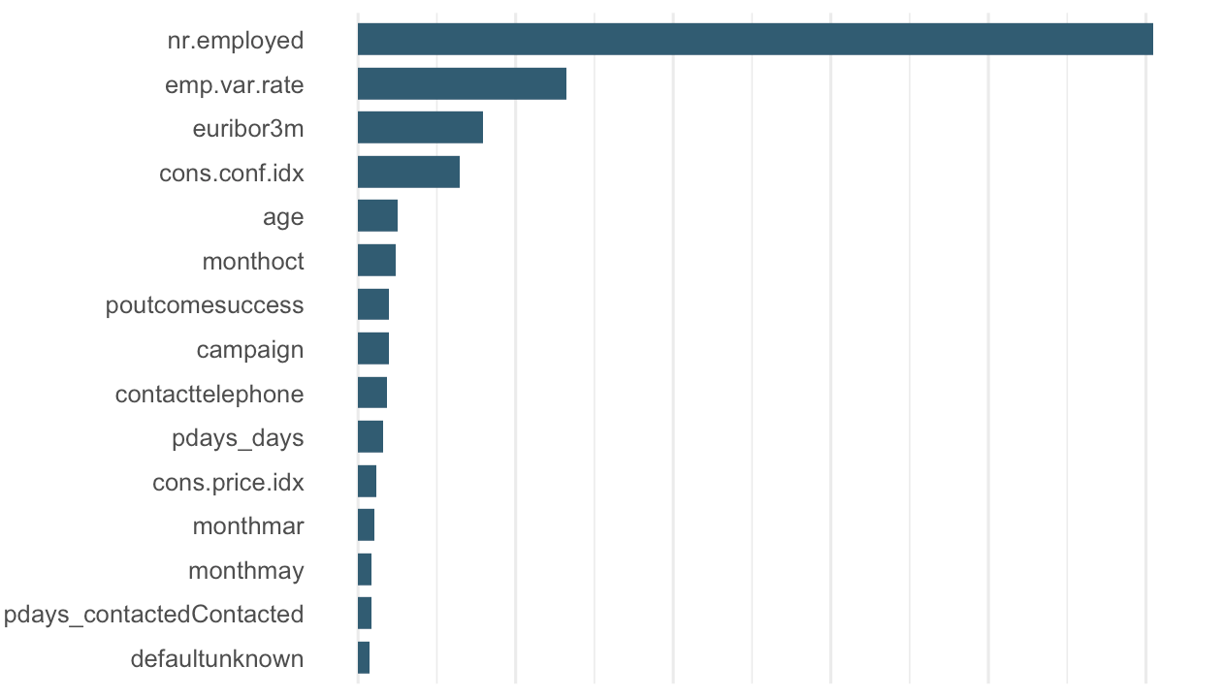
What Drives Predictions—— Main drivers: macroeconomic context and campaign history
Confusion matrix: threshold 0.65
XGBoost gain-based importance
Figure 8a. XGBoost confusion matrix.
Figure 8b. Gain-based feature importance.
XGBoost recovered 554 of 928 actual subscribers
Graph shows predictive contribution, not causal direction
Macro conditions dominate: employment, interest-rate, and confidence indicators
Marketing history matters: prior success, contact month, contact channel, campaign count
Business trade-off: 554 subscribers recovered, with 634 extra false-positive calls
Notes:
Two halves. The confusion matrix shows the trade-off in concrete numbers: 554 true positives and 634 false positives at our tuned 0.65 threshold. The importance chart says the model relies first on macroeconomic conditions: employment levels, employment variation, three-month Euribor, and consumer confidence. Then it uses campaign signals: prior success, contact month, repeated outreach, and contact channel. One caveat: gain importance measures contribution to split quality, not direction or causation. Use it to focus marketing attention, not to claim causal effects. [transition cue] We close with limitations and our recommendation.

Slide 11
Recommendation & Future Work
Recommendation
Limitations
Deploy: Weighted XGBoost for balanced subscriber targeting
Replace random split with time-based validation
Replace F1-based threshold with business cost-benefit threshold
Alternative: Random Forest when reducing wasted calls is prioritized
Evaluate probability calibration
Explainability benchmark: Logistic / LASSO for interpretable comparisons
Examine fairness across customer segments
Final takeaway: evaluate targeting by positive-class retrieval, not raw accuracy.
Notes:
Our recommendation is Weighted XGBoost as the primary targeting model, Random Forest as a precision-leaning backup, and logistic models as interpretable benchmarks. Four limitations matter. Use time-based validation because macro conditions change. Set thresholds with a business cost-benefit matrix, not F1 alone. Check calibration, and study fairness across customer segments. Thank you. [transition cue] Happy to take questions.

Slide 12
Thank you -- Q&A?
Chaoran Chen · Haoyang Liu · Haonan Li
UCI Bank Marketing dataset · Moro, Cortez & Rita (2014)
Notes:
Thank you for listening. We are happy to take your questions about the data, validation design, model comparison, or deployment limitations. [transition cue] End.

